Slide 1


Receipt and Invoice Digitizer
Extraction Analytics
Abhay Maurya
Pattem Dharmika
Harini Kaveti
Vaibhavi Vernekar
Internship 2025-26

Slide 2

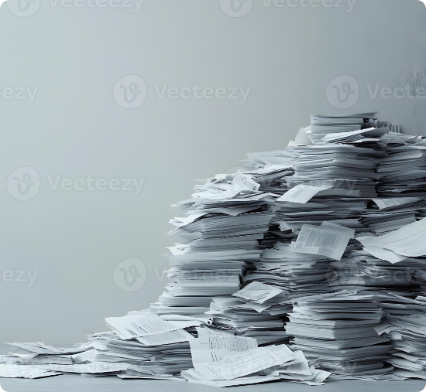
Problem Statement
Inefficient Manual Management: Sorting and typing data from physical receipts is time-consuming and error-prone.
Unstructured Data: Receipts come in various formats, making it difficult to extract structured data systematically.
Lack of Insights: Hard to analyze spending patterns or vendor distribution from piles of paper.
Unreliable OCR: Standard OCR systems often fail without context validation or vendor-specific templates.

Slide 3






Project Objectives
Automate & Extract
Structure & Store
Analyze & Visualize
Fully automate receipt digitization using AI to extract structured financial data from images.
Convert unstructured image data into a clean, queryable SQLite database format.
Provide an interactive analytics dashboard for visual insights on spending and vendors.

Slide 4




Milestone Progress
Milestone 1
Milestone 2
Milestone 3
Milestone 4
OCR Extraction Database Storage
Data Validation Duplicate Detection
Dashboard UI Charts & Analytics
Template Parsing Accuracy Boost

Slide 5
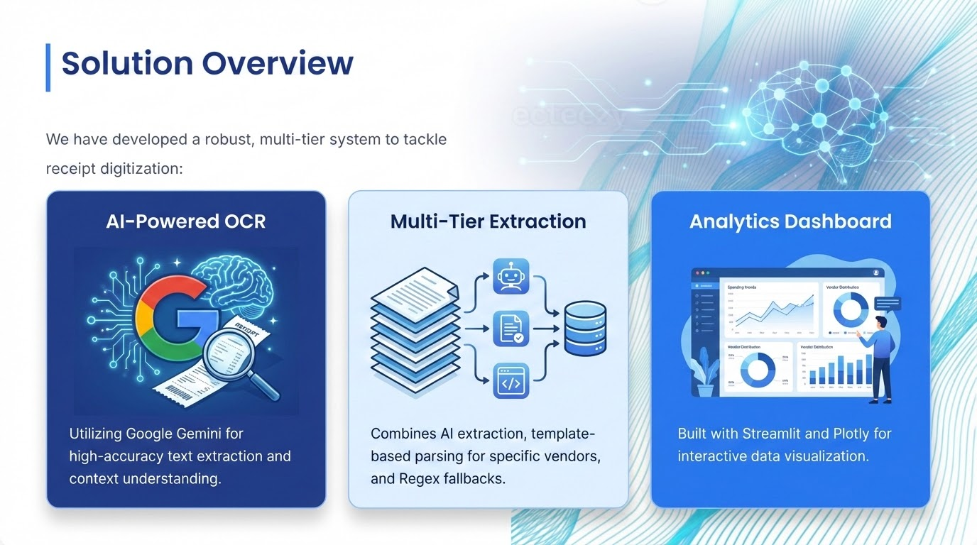

Slide 6
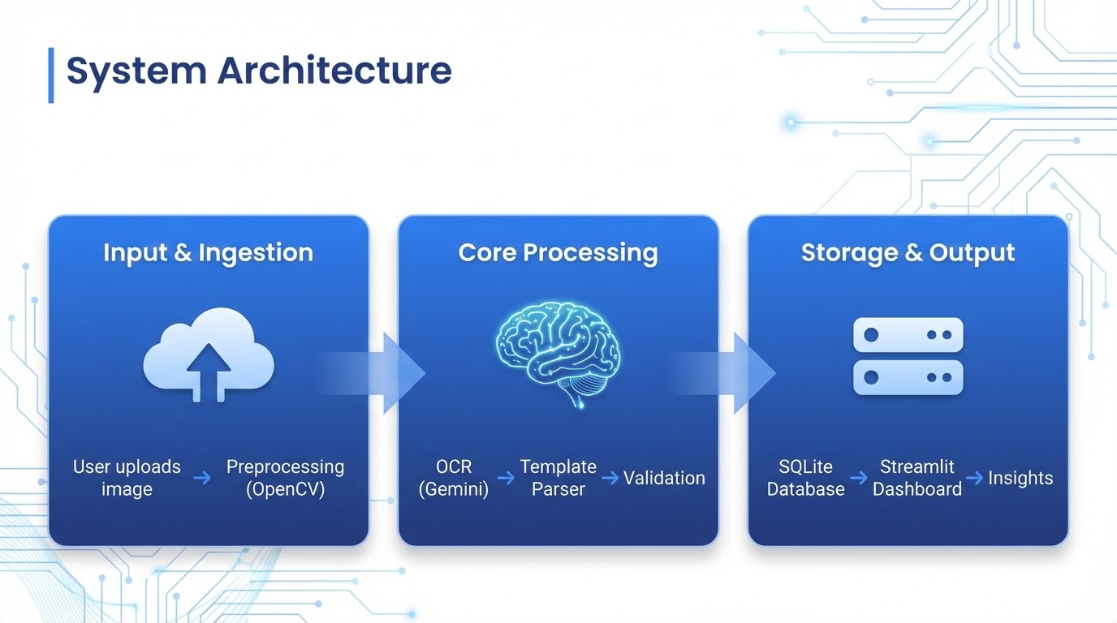



System Architecture
Input & Ingestion
User uploads image -> Preprocessing (OpenCV)
Core Processing
OCR (Gemini) -> Template Parser -> Validation
Storage & Output
SQLite Database -> Streamlit Dashboard -> Insights

Slide 7










Technology Stack
Frontend
Backend
AI & Processing
Data & Visualization

Slide 8






Core Modules
1. Ingestion Module
4. Analytics Module
Handles image uploads and basic preprocessing.
Calculates KPIs, totals, and category breakdowns.
2. OCR & Template Module
5. Visualization Module
Extracts text using AI and maps to vendor templates.
Generates interactive charts using Plotly.
3. Database Module
6. Insights Module
Manages schema and CRUD operations for receipts.
Derives actionable intelligence from the data.

Slide 9
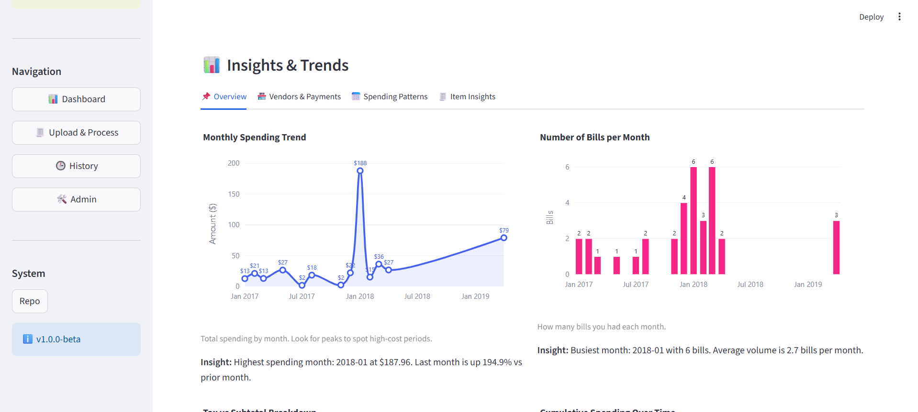
Dashboard & Analytics
KPI Metrics: Total spending, average transaction value, total receipts processed.
Monthly Trends: Line charts showing spending behavior over time.
Vendor Analysis: Bar charts identifying top vendors by spend.
Category Distribution: Doughnut charts for expense categories (Food, Travel, etc.).

Slide 10
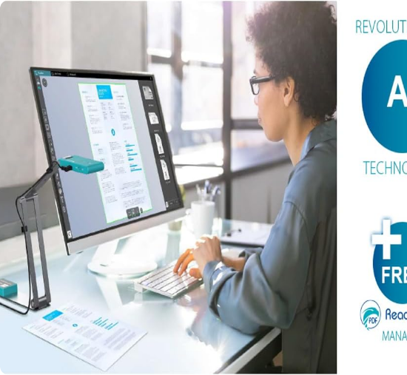
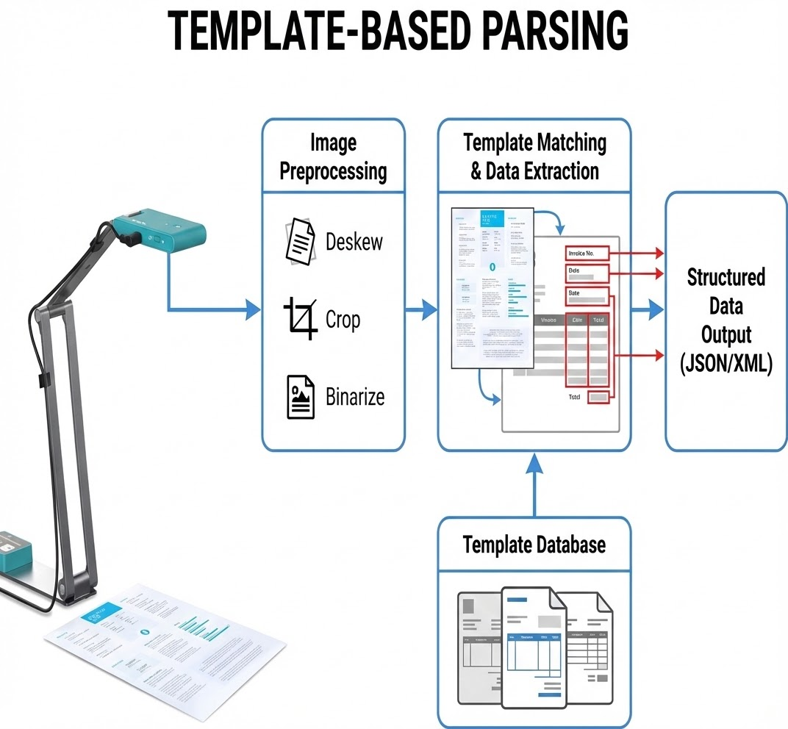

Template-Based Parsing
Why Templates?
While AI is powerful, vendor-specific templates ensure 100% accuracy for recurring formats.
Pattern Recognition: Identifies specific vendors (e.g., Walmart, Uber).
Structured Extraction: Uses predefined regex coordinates for date, total, and tax.
Reliability: Reduces dependency on AI interpretation for known formats.

Slide 11
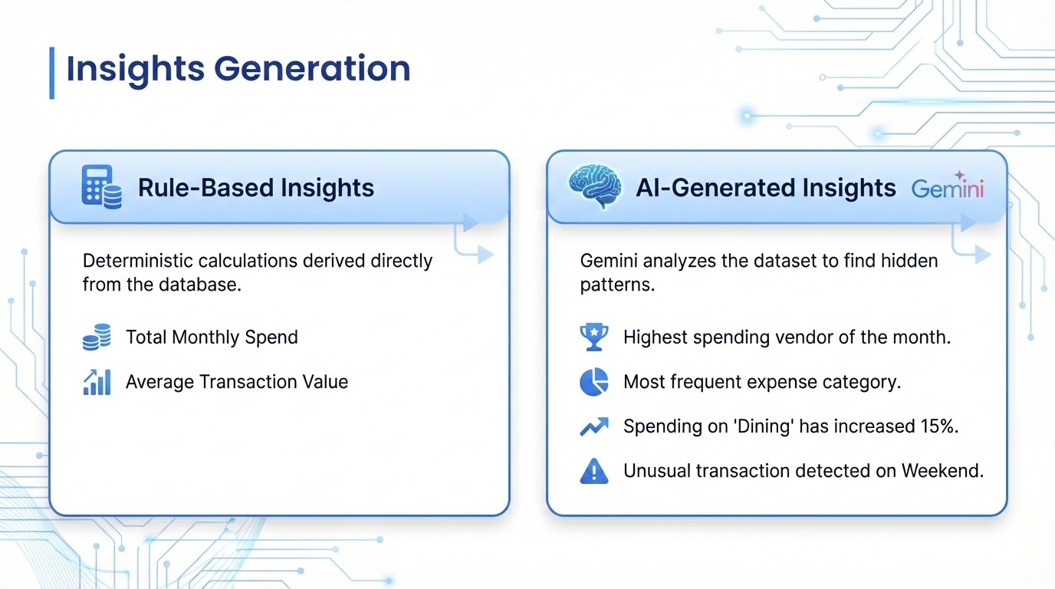

Slide 12





Application Demo Flow
The system ensures a seamless transition from raw image to actionable insight in seconds.

Slide 13
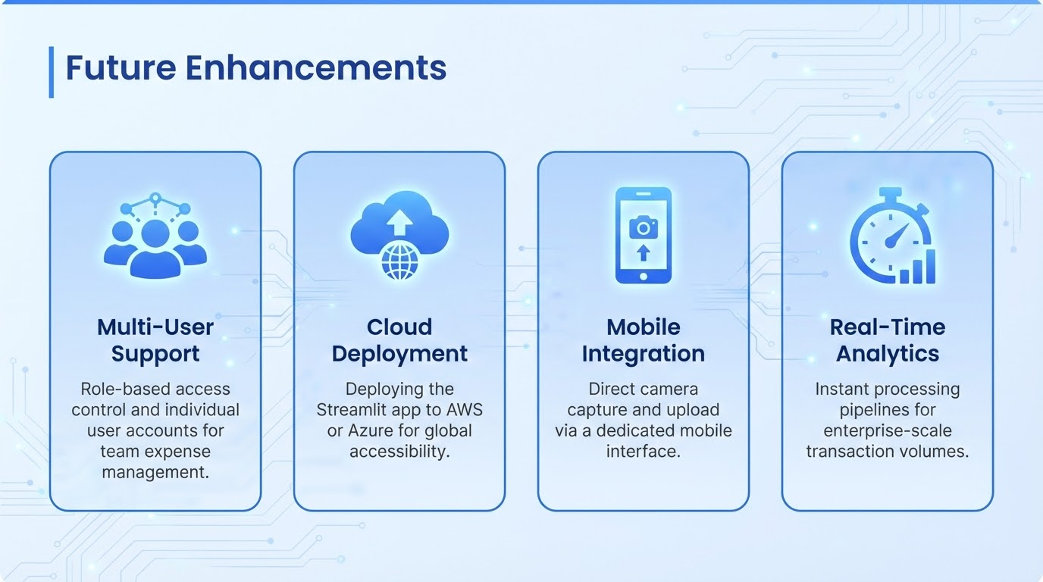

Slide 14
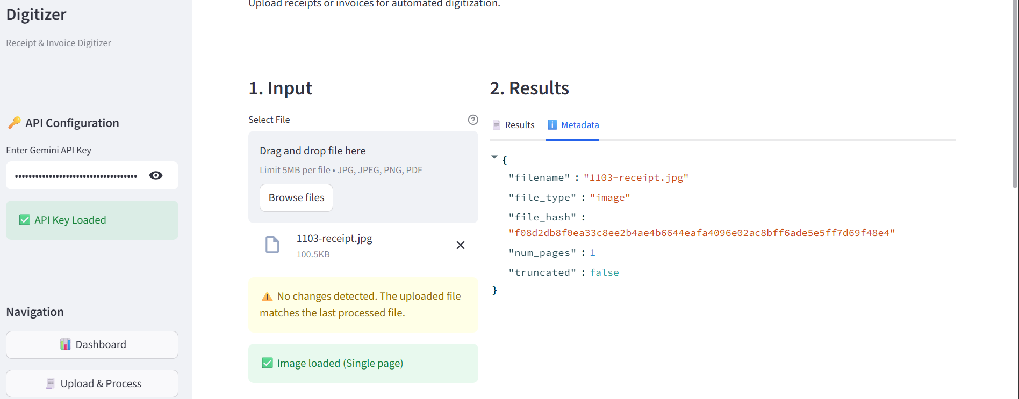
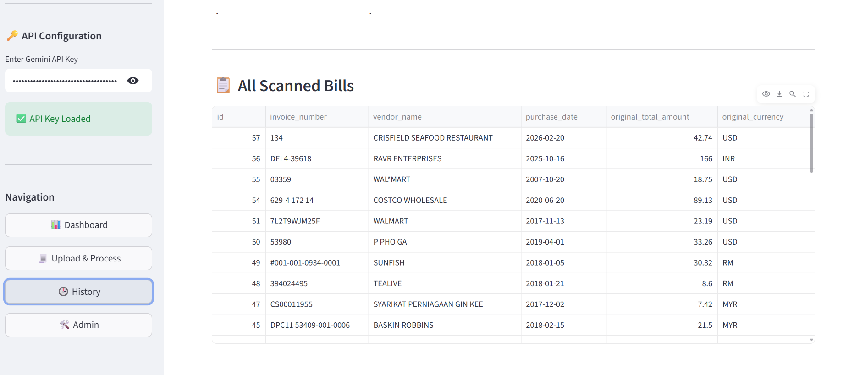
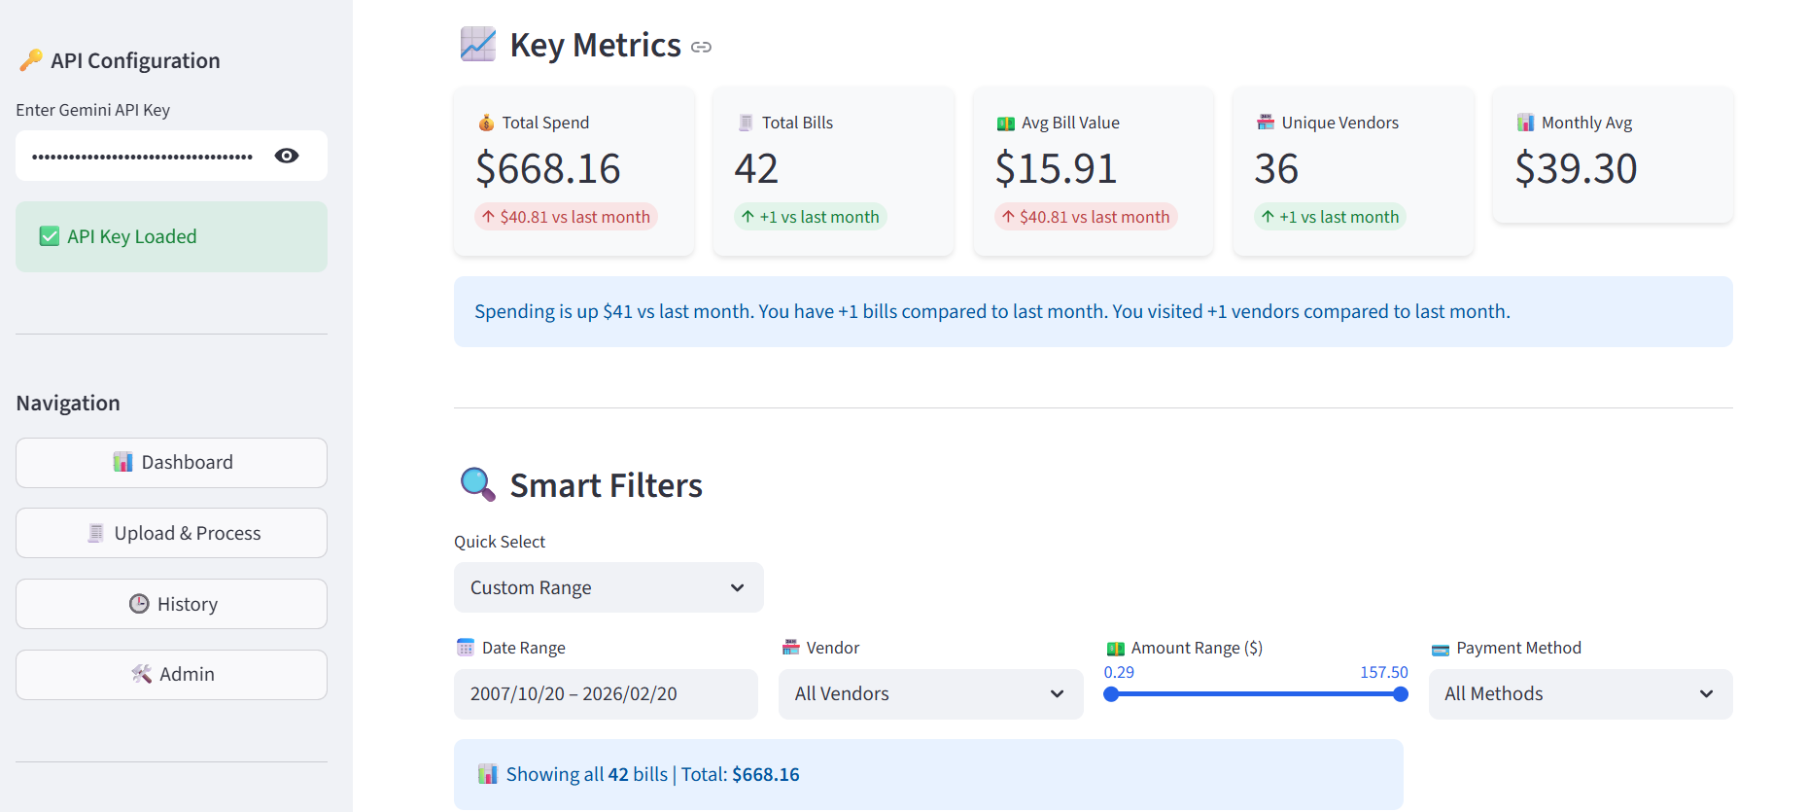
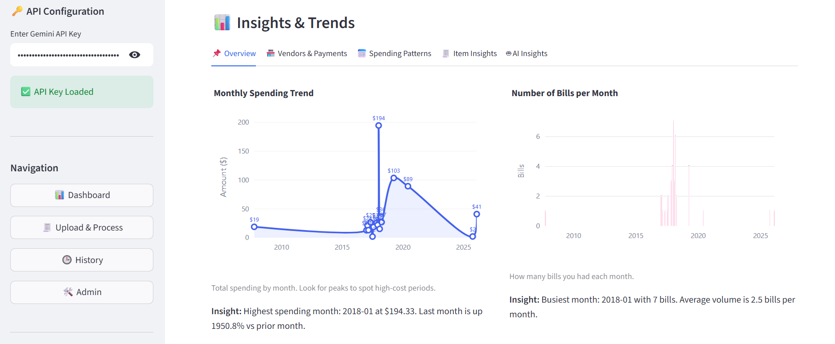
Final Output

Slide 15
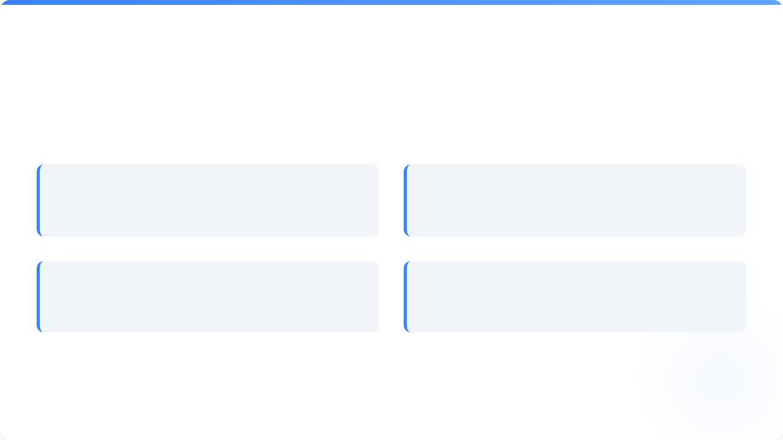



Team Roles & Responsibilities
Abhay Maurya
Harini Kaveti
Visualization Module
Analytics Module
Charts & Dashboard Integration
KPI Calculations & Logic
Vaibhavi Vernekar
Pattem Dharmika
Dashboard UI
Reporting Module
Streamlit Development
Export & Reporting Features

Slide 16



Conclusion
Fully Automated Digitization
Eliminates manual entry with high-speed processing.
High Accuracy
Hybrid approach using Gemini AI and Template Parsing.
Actionable Intelligence
Professional dashboard transforms raw data into business value.

Slide 17
References
🔹Research Papers
[1] A. Smith and J. Doe, “Automated receipt data extraction using OCR and machine learning,” International Journal of Computer Applications, vol. 182, no. 10, pp. 25–31, 2021.
[2] S. Kumar and R. Patel, “Template-based document information extraction,” IEEE Access, vol. 9, pp. 12345–12356, 2022.
🔹 Books
[3] R. C. Gonzalez and R. E. Woods, Digital Image Processing, 4th ed. Pearson, 2018.
[4] T. M. Mitchell, Machine Learning. New York, NY, USA: McGraw-Hill, 1997.
🔹 Online Resources
[5] OpenCV, “Open Source Computer Vision Library,” 2024. [Online]. Available: https://opencv.org
[6] Google AI, “Gemini API Documentation,” 2024. [Online]. Available: https://ai.google.dev
[7] SQLite Consortium, “SQLite Documentation,” 2024. [Online]. Available: https://www.sqlite.org/docs.html
[8] Streamlit Inc., “Streamlit Documentation,” 2024. [Online]. Available: https://docs.streamlit.io
[9] Plotly Technologies Inc., “Plotly Python Graphing Library,” 2024. [Online]. Available: https://plotly.com/python/

Slide 18

Thank You!

